Slide 1
The Scholar’s Guide
to ITI Scholarship Center, Toronto (Canada)

Slide 2
Congratulations!
for having this brilliant learning opportunity

Slide 3
Contents
Introduction to ITI, Toronto and affiliated institutions
Applying for work permit
Registration with University of Toronto (U of T)
Registration with Royal College of Dental Surgeons of Ontario (RCDSO)
Registration with SickKids Hospital
Registration with Research Ethics Board (REB)
Registration with ITI Toronto Study Club
Your arrival in Toronto

Slide 4
Introduction to ITI, Toronto and affiliated institutions

Slide 5
About the Scholarship Center
The University of Toronto Scholarship Center program is housed primarily at Holland Bloorview Kids Rehabilitation Hospital with its state-of-the-art dental clinic.
ITI Scholars will also have the opportunity to spend time at some of the other teaching hospitals and the University of Toronto.
At Holland Bloorview, and Hospital for Sick Children, a great deal of experience has been gathered on dental implants in children, adolescents and young adults, along with a wide variety of unique craniofacial syndrome patients, cleft lip and palate patients, post-tumor ablation patients and patients with post-traumatic defects.
Holland Bloorview and Hospital for Sick Children foster interdisciplinary care through close collaboration between the disciplines of prosthodontics, orthodontics and oral and maxillofacial surgery.
City Square dental is Dr. Carmichaels private dental office which caters to the prosthodontic needs of patients in the city of Toronto.

Slide 6
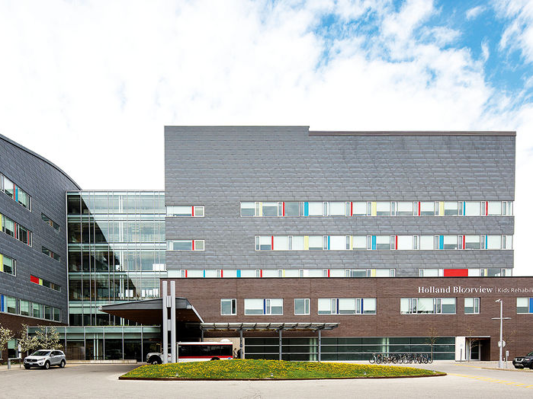
Holland Bloorview Kids Rehabilitation Hospital
Address & Telephone Numbers
Holland Bloorview Kids Rehabilitation Hospital
150 Kilgour Road
Toronto, Ontario, Canada
M4G 1R8
Hospital
416-425-6220
Toll Free: 1-800-363-2440
Dental and Cleft Lip and Palate Service: 416 425 6220 ext. 3465
Website: https://hollandbloorview.ca/

Slide 7
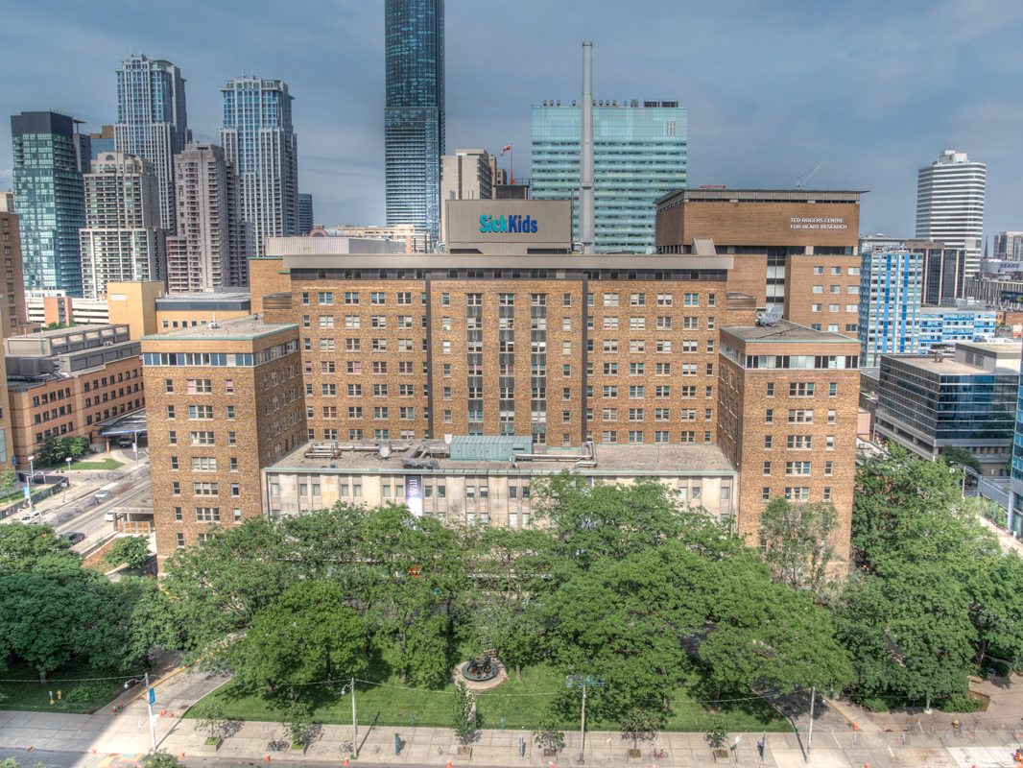
Hospital for Sick Children
Address & Telephone Numbers
The Hospital for Sick Children (SickKids)
University Avenue, between Gerrard and Elm St. Main hospital entrance: 170 Elizabeth St.
Hospital: 416-813-1500
Website: https://www.sickkids.ca/

Slide 8
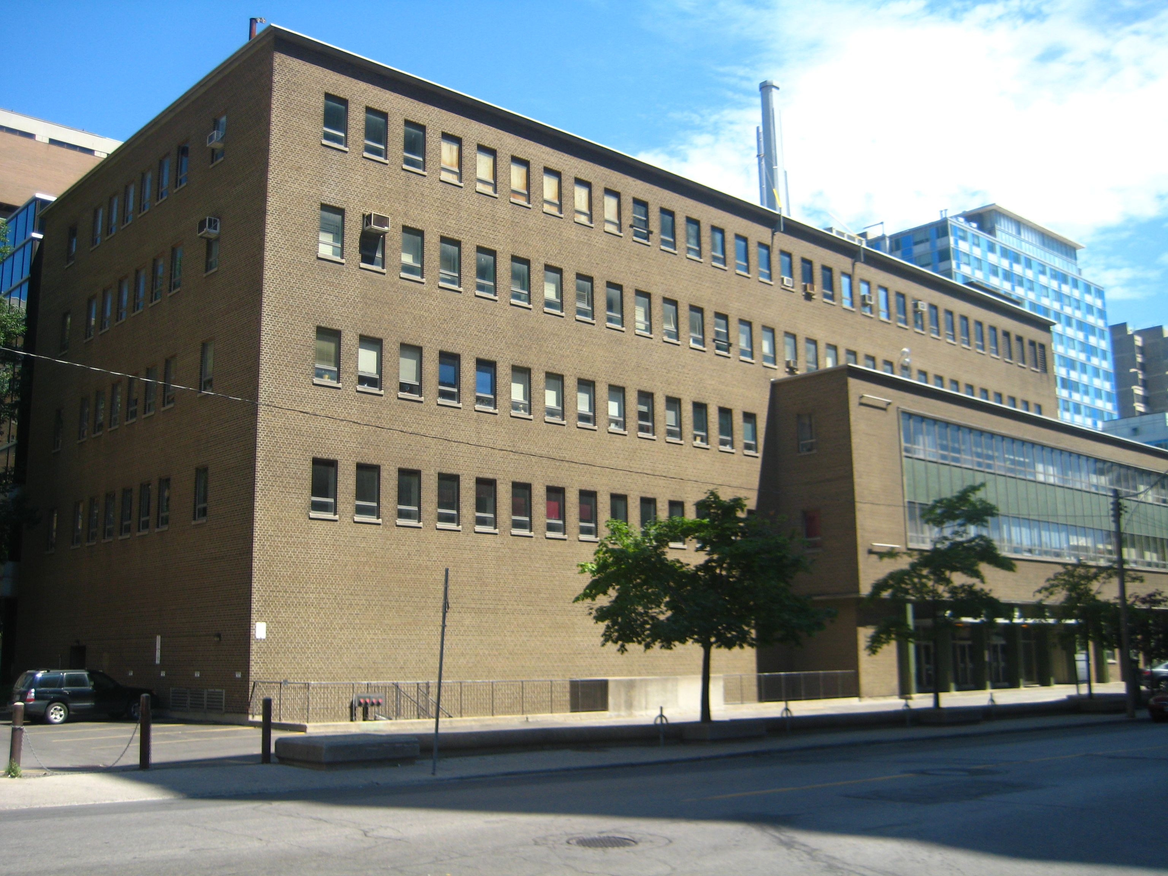
University of Toronto
University of Toronto - Faculty of Dentistry
124 Edward Street
Toronto, Ontario M5G 1G6
https://www.dentistry.utoronto.ca/

Slide 9
City Square Dental Group
Thomson building,Suite 1406 -65 Queen Street West ,Toronto ON
416-883-0072

Slide 10
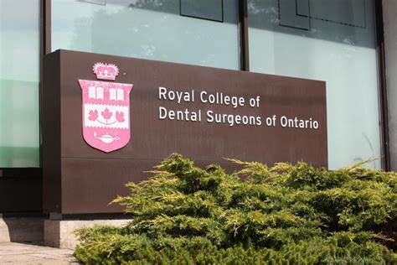
Royal College of Dental Surgeons of Ontario (RCDSO)
Royal College of Dental Surgeons of Ontario
6 Crescent Rd, Toronto, ON M4W 1T1
T: 416-961-6555 | T: 1-800-565-4591 | F: 416-961-5814
info@rcdso.org

Slide 11
Chair: Dr. Robert P. Carmichael (B.SC., D.M.D., M.SC., FRCDC)
Chief of Dentistry, Holland Bloorview Kids Rehabilitation Hospital
Ontario Dental Association Service Award (2015)
Fellow, Royal College of Dentists Canada
Fellow, ITI
Email:
rcarmichael@hollandbloorview.ca
rpcarmichael@icloud.com
Suite 2e-285, 150 Kilgour Road
Toronto Ontario M4G 1R8 CANADA
T 416.425.6220 (x3465)
C 416.818.0610
F 416.424.3839

Slide 12
Getting familiar
You will need
a work permit (visa) to arrive
U of T registration to work in Canada, apply for RCDSO license and access U of T digital library
RCDSO license to work on patients and a SickKids hospital
REB approval for conducting research

Slide 13
Applying for work permit

Slide 14
Anticipated expenditures
Visa application
English test
Biometric records
Mailing your passport for visa stamp
LMIA exempt letter (to be paid by HB)

Slide 15
Creating your account
Open IRCC website
https://IRCC.website/
Create a GCKey account
Start your application for work permit

Slide 16
Applying for English test
You must have either of the following:
For TOEFL – minimum scores of 600 PBT, 250 CBT or 100 ITB.
For IELTS – a minimum band of 6.5 for the General test.

Slide 17
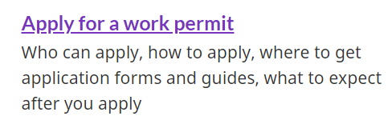
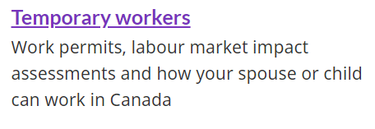
On IRCC website
Read the instructions on IRCC website for your application. The guidelines and time period to obtain a work permit keep changing.
Here’s what you should be looking for

Slide 18
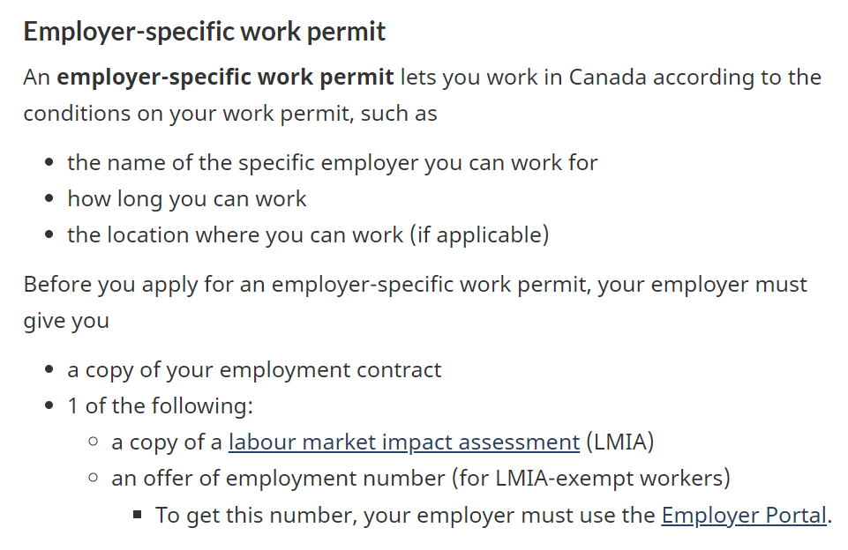
Type of work permit

Slide 19
Choose these options

Slide 20
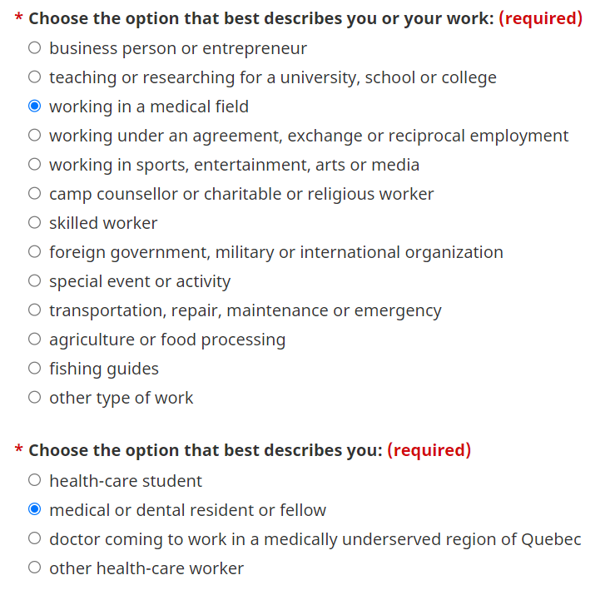
Choose these options

Slide 21
Check the general eligibility requirements

Slide 27
Biometrics
After creating your account, you will have to schedule and appointment with your nearest IRCC center to provide your biometric records.

Slide 28
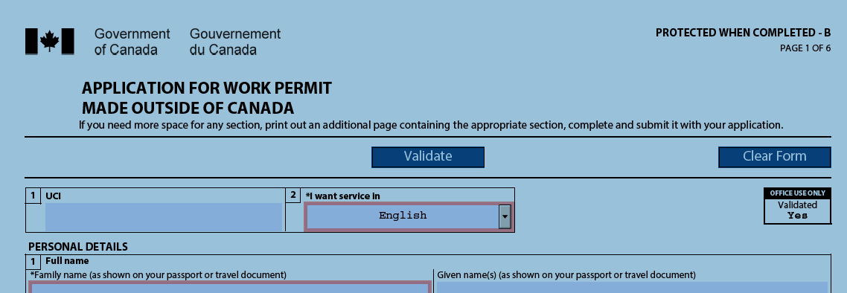
Application
From your GCKey account, fill in the application form

Slide 29
Application
The details of workplace are as follows:

Slide 30
Document Summary
Employment reference letter (by HB)
Employment records (by HB)
Letter from current employer (by HB)
Employment contract (by HB + ITI)
Passport
Education (Degree/ Diploma)
Digital photo
CV
Medical assessment (?)
Family form
Proof that you meet the requirements of the job being offered (RCDSO)
LMIA Exempt (by HB)

Slide 31
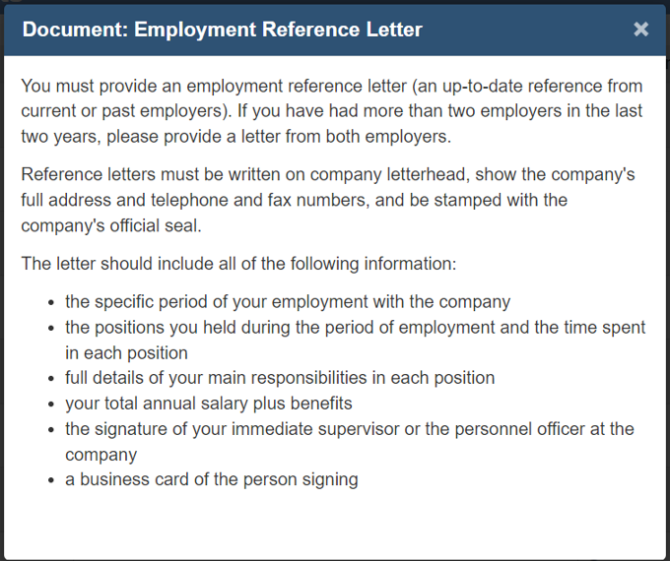
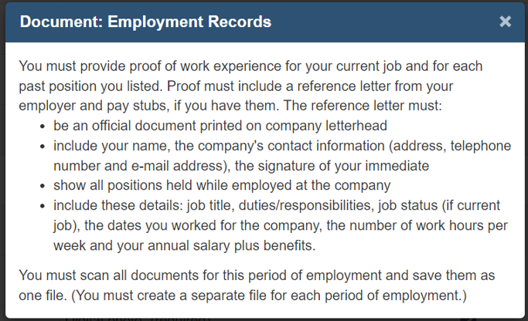
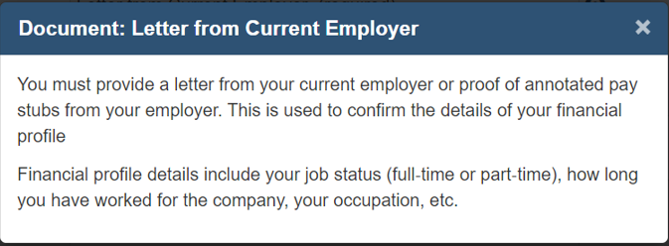
Letter from current employer

Slide 32
Letter from current employer
This is the letter to be uploaded.
This letter will be provided by Dr. Carmichael.

Slide 33
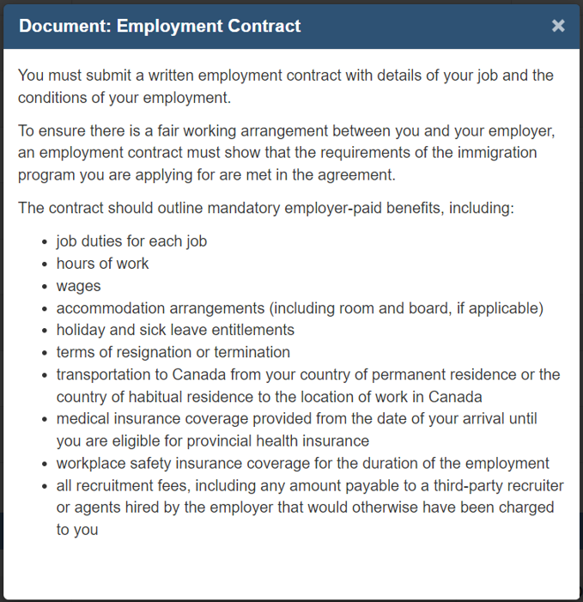
Application

Slide 34
Application
You can also attach this letter with employment letter to support your application.
This will be provided by ITI.

Slide 35
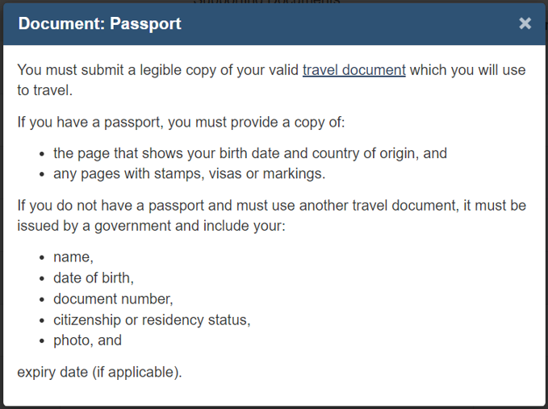
Application

Slide 36
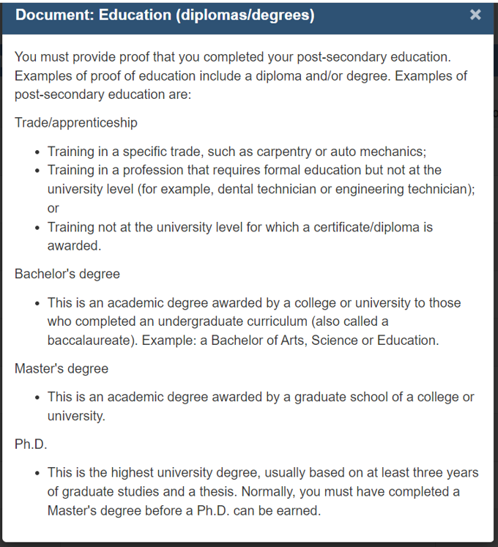
Application

Slide 37
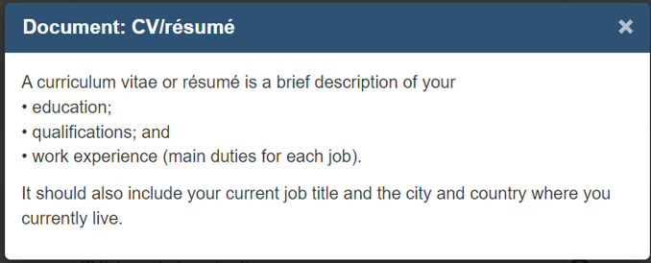
Application

Slide 38
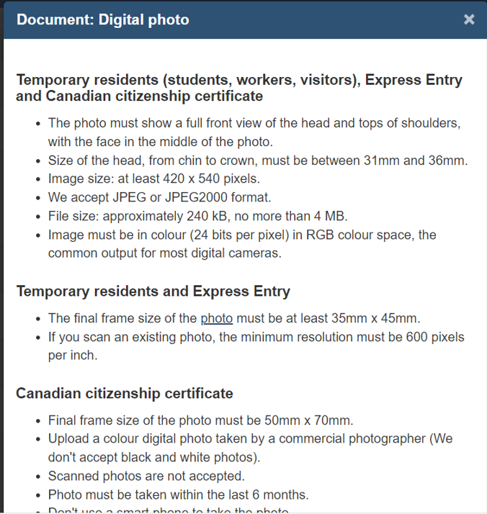
Application

Slide 39
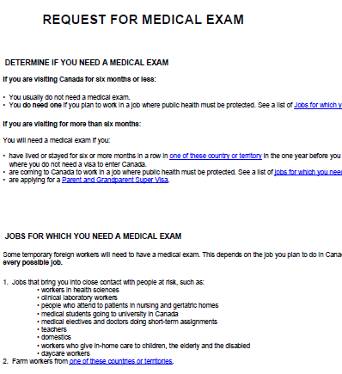
Medical Exam Form
This form is applicable only for certain countries.
After you fill the application, it will take a few weeks to review.
If you need a medical exam, you will be provided a UCI and IME number. Schedule an appointment with IRCC registered hospital for the same. They will take a few days to finish the process. They will directly send your medical report to the IRCC.

Slide 40
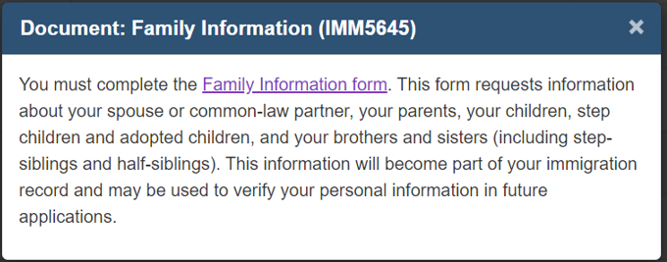
Application

Slide 41
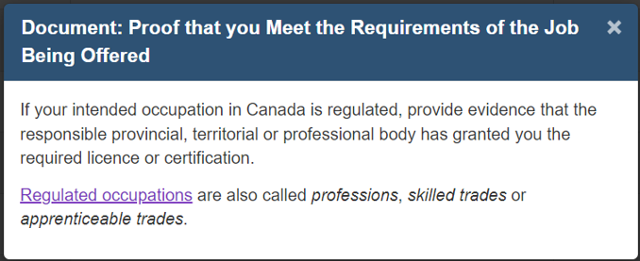
Application
For this, you need to apply for RCDSO license. You will require your work permit for the license.
You can upload a letter stating that you will procure the license on your arrival.

Slide 42
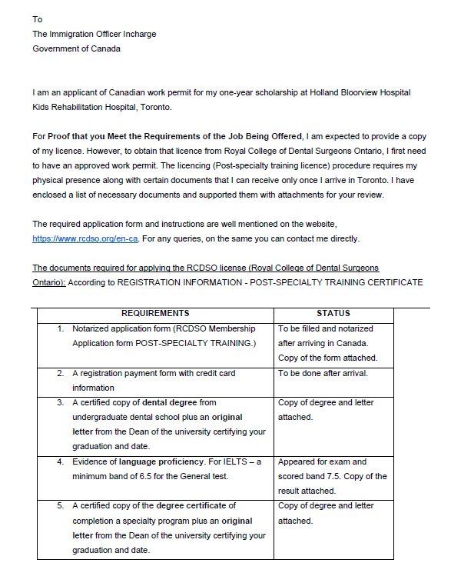
Cover letter

Slide 43
LMIA Exempt
This is an important document. It will be provided by Holland Bloorview on request.

Slide 44
Application review
After you submit your application, you will hear back from IRCC in few weeks.
Until then you should gather necessary documents for RCDSO license.
Once you get an email from IRCC, you will be required to submit your passport at the IRCC center in your country. You can do it by hand or by mail.
You will then receive a visa stamp/ sticker on your passport in a week.
Send a copy of this to Dr. Carmichael.
Book your tickets and pack your bags!

Slide 45
Registration with University of Toronto (U of T)

Slide 46
Document Summary
Application form (provided by U of T)
Work permit (You will receive this document at the airport after immigration)
Passport
Immunization record (from your family physician, form provided by U of T)
TB test (from your family physician/ HB)
Local address
RCDSO license (cover letter stating that it’s applied for)
CPR certificate (to be taken In-Person, fee involved)
Application fee (CAD 850+)

Slide 47
Who to contact?
Lisa Hutchinson
Registrar
Faculty of Dentistry | University of Toronto
124 Edward Street, Room 104 | Toronto, ON | M5G 1G6
416.979.4901 ext. 4374 (V) 416.979.4944 (F)
Email: gradstudies@dentistry.utoronto.ca
www.dentistry.utoronto.ca

Slide 48
U of T Application Form
You will be provided a form to fill in all your details.

Slide 49
Work permit
You will receive this document at the airport after immigration.
Send a copy to Dr. Carmichael

Slide 50
Immunization record
You can request the link to upload these documents on your SYNERGY ACCOUNT and form prior to arrival and get it filled by your family physician.
(FEE involved 60+CAD)

Slide 51
CPR/AED/First-Aid certificate
You have to apply for this course In-person and you can complete the course before arrival to save your time here.

Slide 52
Immunization record
You will then receive a verification of the documents on your SYNERGY ACCOUNT

Slide 53
Library Access
Request an email to U of T to provide UTORID login credentials after your U of T registration is complete.

Slide 54
Registration with Royal College of Dental Surgeons of Ontario (RCDSO)

Slide 55
Overview
This is a challenging part of your application.
You can either apply for a temporary license beforehand or you can apply after arrival.
It takes 2-3 months to process.
Since you require your work permit (which you will receive after immigration) for this registration, you can apply 2 months prior to flying to Canada for a temporary registration and complete the process after arrival.

Slide 56
Who to contact?
Janet Scott
Program Administrator/ Registration
Royal College of Dental Surgeons of Ontario
6 Crescent Road, Toronto, ON M4W 1T1
ph: 416-961-6555 x 4325
fax: 416-961-5814
toll-free: 1-800-565-4591

Slide 57
Document Summary
Application form (online link to be obtained from RCDSO)
Certified copy of dental degree and transcripts + a letter from the Dean of your university certifying the same (Bachelors, Masters, Diploma, Internship)
IELTS/ TOEFL score card
Work permit
Certificate of standing from dental council of your country
Offer letter from U of T
Credit card details

Slide 58
Before applying
Complete this course from RCDSO website.

Slide 59
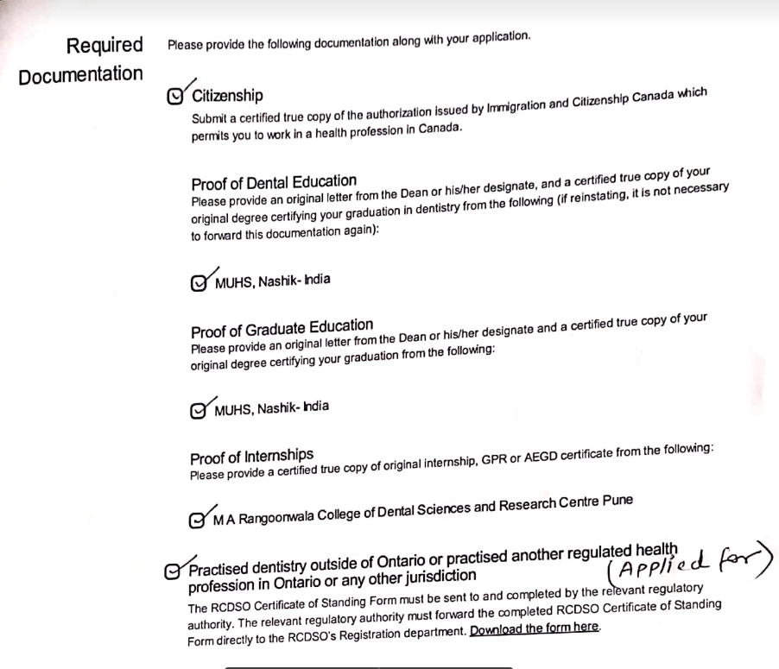
Here’s what needs to be uploaded
Your documents may vary based on your application.

Slide 60
Application
You have to apply for post-specialty training program

Slide 61
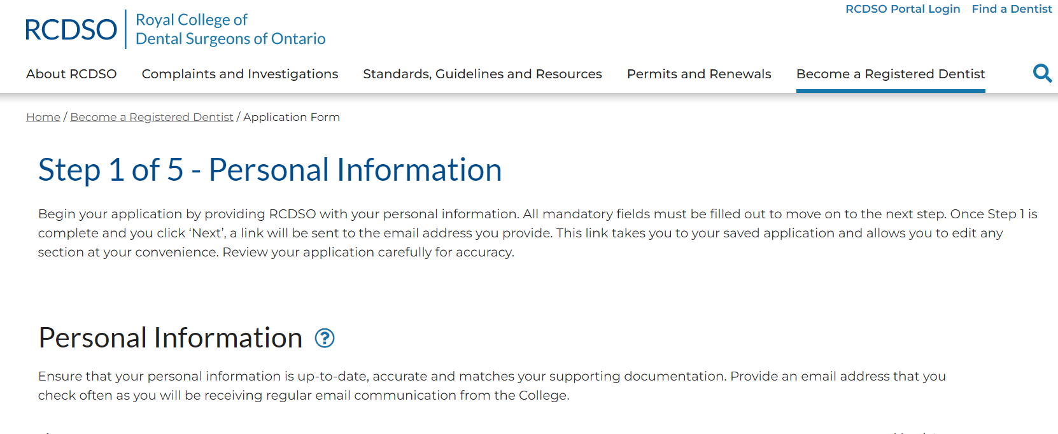
Application
You have to request the RCDSO to provide you a suitable link for the same. Fill in the application, print it and sign it.
Send the copy to Dr. Carmichael to sign if you are applying from your country prior to arrival and submit with the requested documents.

Slide 62
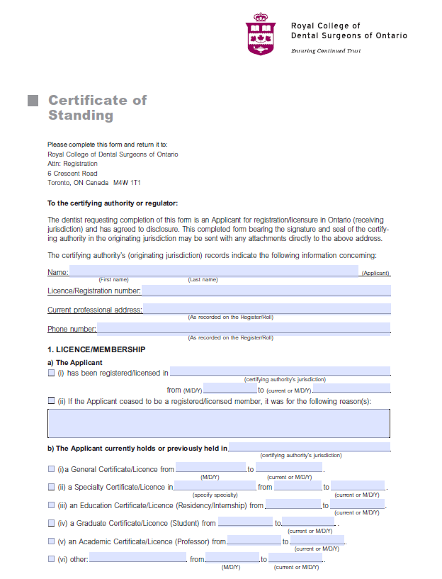
Certificate of standing
Download this form from the RCDSO website and get it filled from the dental council of your country. This form has to be sent to RCDSO directly by the council.
You cannot submit this yourself.
This one can be a troublemaker.

Slide 63
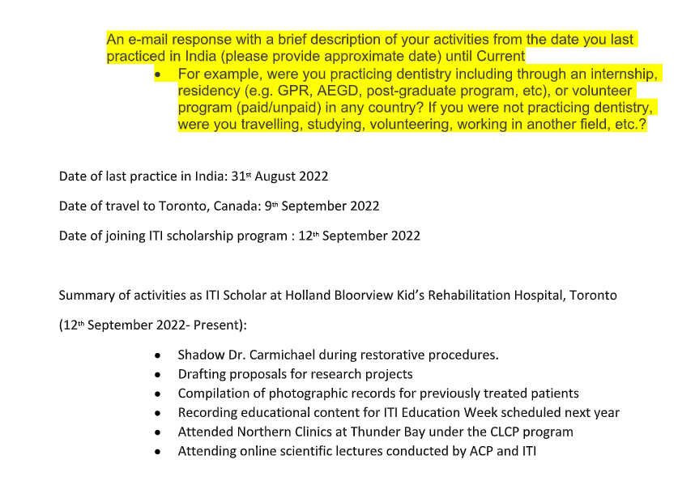
Application
After my application was reviewed, I was asked to provide a letter of explanation with the description of my current activities. This was my response
You may or may not be asked for this.

Slide 64
Payment
The credit card details have to be provided at the time of application submission.
Amount will be deducted after approval of your application.
The amount for the application fee is 150$ and 2995$ annual fee (Year 2023-24)

Slide 65
License
This is the final certificate.
You must share this with Dr. Carmichael, SickKids and U of T for completion of your registration with the university.

Slide 66
Registration with SickKids Hospital

Slide 67
Who to contact?
Helen Cheung
Administrative Assistant, Dentistry Department
The Hospital for Sick Children
555 University Avenue, Toronto, Ontario M5G 1X8
Phone: 416-813-6008 | Fax: 416.813.6375
Email: helen.cheung@sickkids.ca

Slide 68
Document Summary
Registration form (to be filled and returned)
Copy of dental degree
Copy of confirmation of enrolment from U of T Dept of Dentistry
Copy of RCDSO member certificate
Work permit

Slide 69
Confirmation of Enrolment

Slide 70
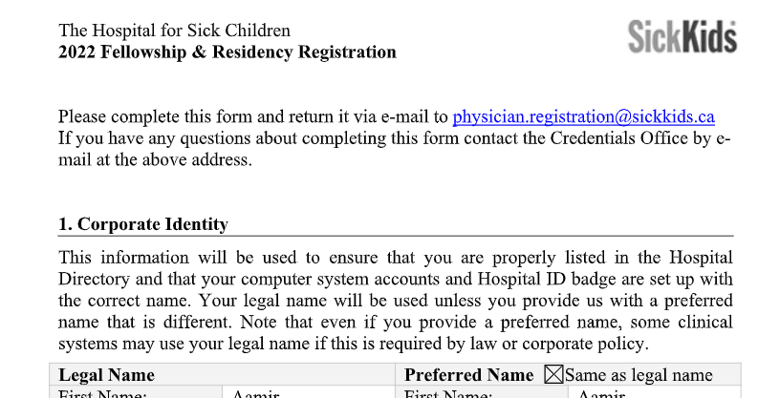
Badge for SickKids
Once you receive your confirmation from SickKids, you will be required to schedule an appointment for the ID badge which is pre-requisite for you to have before joining the dental department.

Slide 71
Registration with Research Ethics Board (REB)

Slide 72
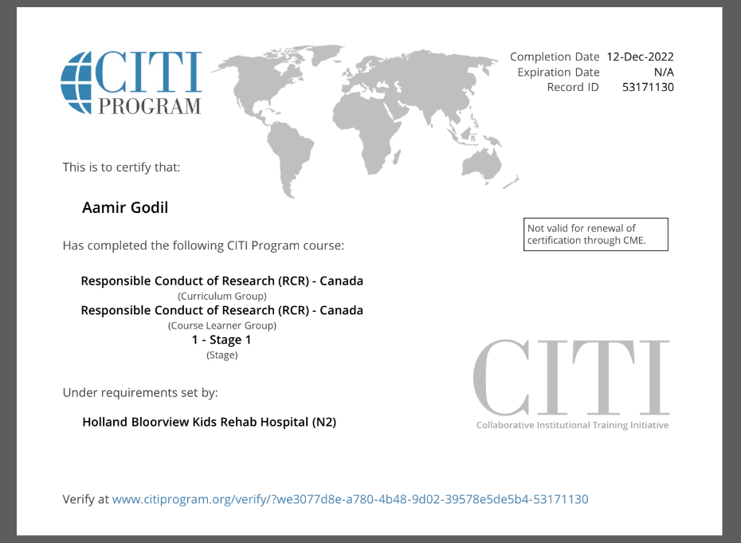
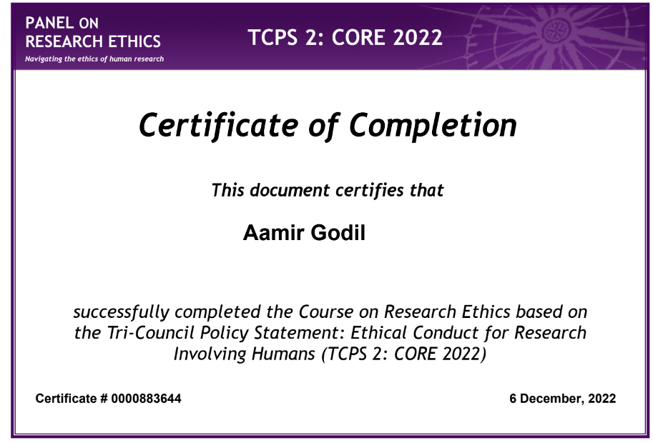
Registration with REB
To conduct any research in Ontario, you must be registered for the proposed research with the REB.
You will be required to undertake 2 courses on research and ethics as a pre-requisite.

Slide 73
TCPS 2: CORE
This course is free of cost and you can take it up online.
You can complete this in advance and email the certificate to Dr. Carmichael.

Slide 74
RCR- CITI
This program has an associated cost if you do it on your own.
However, if you do it through HB, its free.
To register through HB, Dr. Carmichael can request an email to Aurélie Besson (Manager, Office of Human Research Protections Bloorview Research Institute) to provide you the link to Freshdesk.
Once you have the link, you will have to contact Research Operations (Rosceline Andres, Bloorview Research Institute) to activate your account which takes 2-3 days.
You can only do this through your HB email account.

Slide 75
Your arrival in Toronto

Slide 76
What to get?
The cost of living in Toronto is generally high. So you may want to carry all your necessary essentials.
Food and grocery are readily available. Go easy on that. Also, airports have food regulations and you might want to check all the details before flying.
Scrubs are provided at hospitals. You can choose to bring and wear your own.
A few formal sets for study clubs and education week.
Winter wear and thermals.
A universal adapter to connect your chargers and gadgets.

Slide 77
Looking for accommodation
You can look for suitable private accommodation at
condos.ca
kijiji
Facebook marketplace
You can look for rental housing for staff at Sickkids
https://www.sickkids.ca/en/care-services/for-health-care-providers/rental-housing-staff/
( YOU MAY HAVE TO APPLY FOR THIS MONTHS IN ADVANCE)
Keep your accommodation in close proximity to a TTC bus and subway station.
They should be close to Kilgour Road (for Holland Bloorview) and Downtown- St. Patrick’s St (for SickKids and U of T)
If you don’t have an immediate place, you can make arrangements with Holland Bloorview temporarily.

Slide 78
Travel and connectivity
The TTC (Toronto Transit Commission) provides buses, street cars and subways for connectivity within the city.
You can also procure your driver’s license and get a car.

Slide 79
At Holland Bloorview
After you arrive in Holland Bloorview, Dr. Carmichael will write three E-mails and you should remind him to send these emails, this is very important:
The primary e-mail is to Lisa Hutchinson at the Faculty of Dentistry, so Lisa could write to the RCDSO and request the registration in RCDSO.
The second email is to reply Jacob at the ITI center to confirm the arrival of the new ITI scholar. Obviously the new ITI scholar should notify Anna his/her arrival beforehand.
The third email is to Helen Cheung at Sickkids to get the new ITI scholar the status of observer while waiting for his/her credentialing.

Slide 80
Your scholarship funds
The funds will be transferred only to your Canadian bank account.
You can open a bank account by directly visiting them after your arrival.
You will have to carry your original ID (passport) and work permit for the same.
Funds transfer takes nearly 2-3 weeks after your arrival. Ensure you are carrying sufficient money for a month or may be more.

Slide 81
Wishing you the best
for your scholarship year ahead!
Feel free to reach out to us:
Dr. Sanaa Wadwan
ITI Scholar 2023-24
dr.sanaawadwan@gmail.com
Dr. Aamir Godil
ITI Scholar 2022-23
aamirzgodil@gmail.com

